Slide 1


SMILOW CANCER HOSPITAL | 20 YORK STREET, NEW HAVEN, CONNECTICUT
DANIELE R. NAVARRETE | STRUCTURAL OPTION
STRUCTURAL DESIGN & PROGRESSIVE COLLAPSE
“the most comprehensive cancer care facility between Boston and New York City, offering patients state-of-the-art care and treatment.”
http://www.engr.psu.edu/ae/thesis/portfolios/2009/don5000

Slide 2
SMILOW CANCER HOSPITAL | 20 YORK STREET, NEW HAVEN, CONNECTICUT
DANIELE R. NAVARRETE | STRUCTURAL OPTION
PRESENTATION OUTLINE:
Smilow Cancer Hospital Overview
Depth Study
  Structural System Redesign
  Progressive Collapse Design
Breadth Study
  Blast-Resistant Glazing
Conclusions
http://www.engr.psu.edu/ae/thesis/portfolios/2009/don5000

Slide 3

SMILOW CANCER HOSPITAL | 20 YORK STREET, NEW HAVEN, CONNECTICUT
DANIELE R. NAVARRETE | STRUCTURAL OPTION
PROJECT OVERVIEW
http://www.engr.psu.edu/ae/thesis/portfolios/2009/don5000

Slide 4
SMILOW CANCER HOSPITAL | 20 YORK STREET, NEW HAVEN, CONNECTICUT
DANIELE R. NAVARRETE | STRUCTURAL OPTION
BUILDING STATISTICS:
Owner: Yale-New Haven Hospital
497,000 square feet
14 patient floors + 2 mechanical floors
Dates of Construction: September 2006 – October 2009
Overall Project Cost: $253 M
Delivery Method: Design-Bid-Build with GMP
http://www.engr.psu.edu/ae/thesis/portfolios/2009/don5000

Slide 5
SMILOW CANCER HOSPITAL | 20 YORK STREET, NEW HAVEN, CONNECTICUT
DANIELE R. NAVARRETE | STRUCTURAL OPTION
PROJECT TEAM:
Owner - Yale-New Haven Hospital
Architect - Shepley Bulfinch Richardson & Abbott
Construction Manager - Turner Construction Company
Structural Engineer – Spiegel Zamecnik & Shah
Mech./Elec./Plumbing – BR+A Consulting Engineers
http://www.engr.psu.edu/ae/thesis/portfolios/2009/don5000

Slide 6

SMILOW CANCER HOSPITAL | 20 YORK STREET, NEW HAVEN, CONNECTICUT
DANIELE R. NAVARRETE | STRUCTURAL OPTION
CURRENT DESIGN:
Architectural
Part of the Yale-New Haven Hospital Complex
Unitized curtain wall panel system: glass + terra cotta
Two-story lobby with three-story glass awning overhanging front of building
Roof system: combination cast-in-place concrete and metal roof decking
http://www.engr.psu.edu/ae/thesis/portfolios/2009/don5000

Slide 7
SMILOW CANCER HOSPITAL | 20 YORK STREET, NEW HAVEN, CONNECTICUT
DANIELE R. NAVARRETE | STRUCTURAL OPTION
CURRENT DESIGN:
M.E.P.
8 air-handling units: 6 on 5th floor + 2 on roof; 70,000 cfm per AHU
480/277V + 208/120V 3 phase, 4 wire systems
Emergency power: (3) 2000kW/ 2500kVA diesel generators
http://www.engr.psu.edu/ae/thesis/portfolios/2009/don5000

Slide 8
SMILOW CANCER HOSPITAL | 20 YORK STREET, NEW HAVEN, CONNECTICUT
DANIELE R. NAVARRETE | STRUCTURAL OPTION
STRUCTURAL DEPTH
http://www.engr.psu.edu/ae/thesis/portfolios/2009/don5000

Slide 9
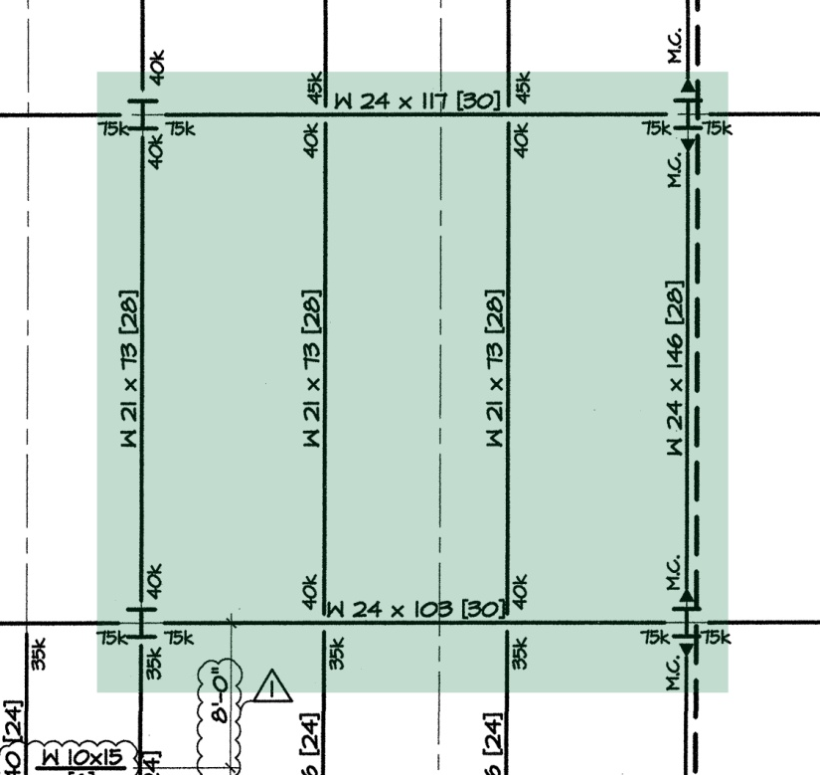
SMILOW CANCER HOSPITAL | 20 YORK STREET, NEW HAVEN, CONNECTICUT
DANIELE R. NAVARRETE | STRUCTURAL OPTION
STRUCTURAL DEPTH:
Current Structural System
Steel Moment & Gravity Frames + (4) Reinforced Concrete Shear Walls
Typical Bay: 30’ x 30’
Floor System: 4-1/2” thick concrete slab on 3” metal deck
Beams: W18/21/24
Girders: W24
Columns: W12/14/24, HSS, cruciform, reinforced concrete
Foundation: 4’ thick reinforced concrete mat slab (8’ at shear wall locations)
http://www.engr.psu.edu/ae/thesis/portfolios/2009/don5000

Slide 10
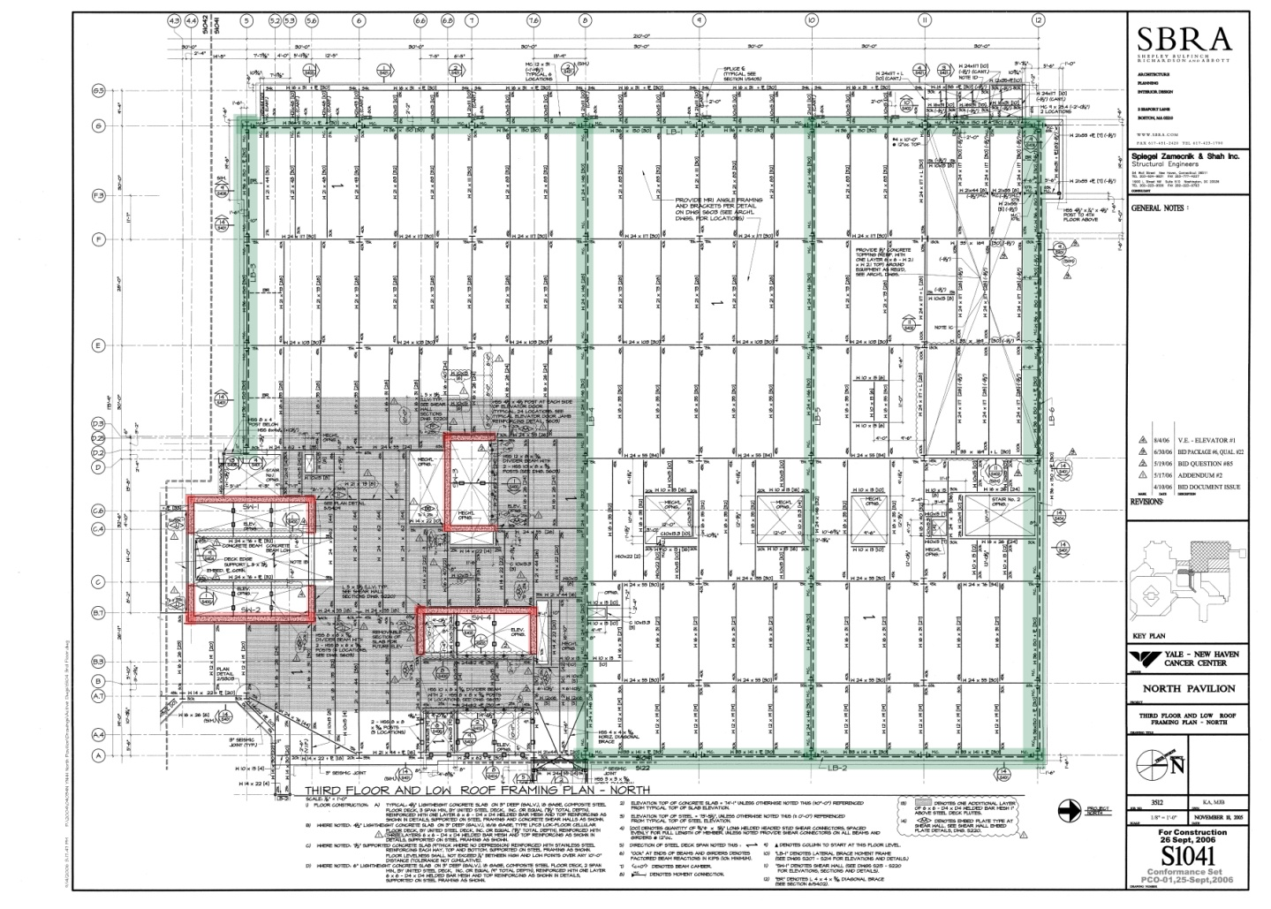
SMILOW CANCER HOSPITAL | 20 YORK STREET, NEW HAVEN, CONNECTICUT
DANIELE R. NAVARRETE | STRUCTURAL OPTION
STRUCTURAL DEPTH:
Typical Framing Plan: Floors 1 - 5
http://www.engr.psu.edu/ae/thesis/portfolios/2009/don5000

Slide 11
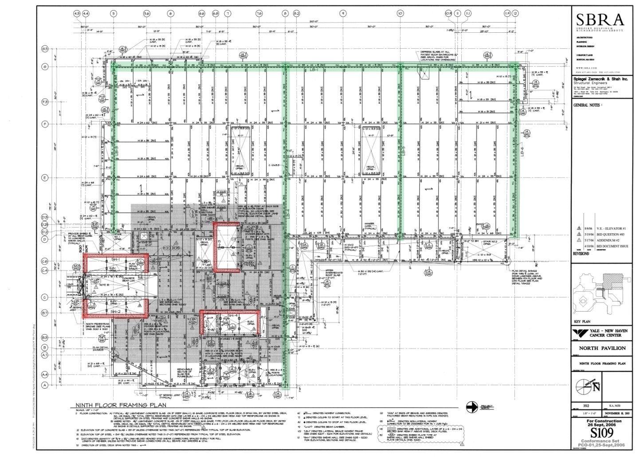
SMILOW CANCER HOSPITAL | 20 YORK STREET, NEW HAVEN, CONNECTICUT
DANIELE R. NAVARRETE | STRUCTURAL OPTION
STRUCTURAL DEPTH:
Typical Framing Plan: Floors 7 - 17
http://www.engr.psu.edu/ae/thesis/portfolios/2009/don5000

Slide 12
SMILOW CANCER HOSPITAL | 20 YORK STREET, NEW HAVEN, CONNECTICUT
DANIELE R. NAVARRETE | STRUCTURAL OPTION
STRUCTURAL DEPTH:
Proposed Reinforced Concrete Structural System
Design criteria based on ACI 318-05
ASCE 7 Load Combination: 1.2D + 1.0E + 1.0L + 0.2S
Typical flexural members designed for moment and shear capacities as well as live load deflection.
Typical interior columns designed for axial loads using design aid charts from Design of Concrete Structures, 13th edition, by Nilson, Darwin, and Dolan.
(K_{n} versus R_{n} charts)
http://www.engr.psu.edu/ae/thesis/portfolios/2009/don5000

Slide 13
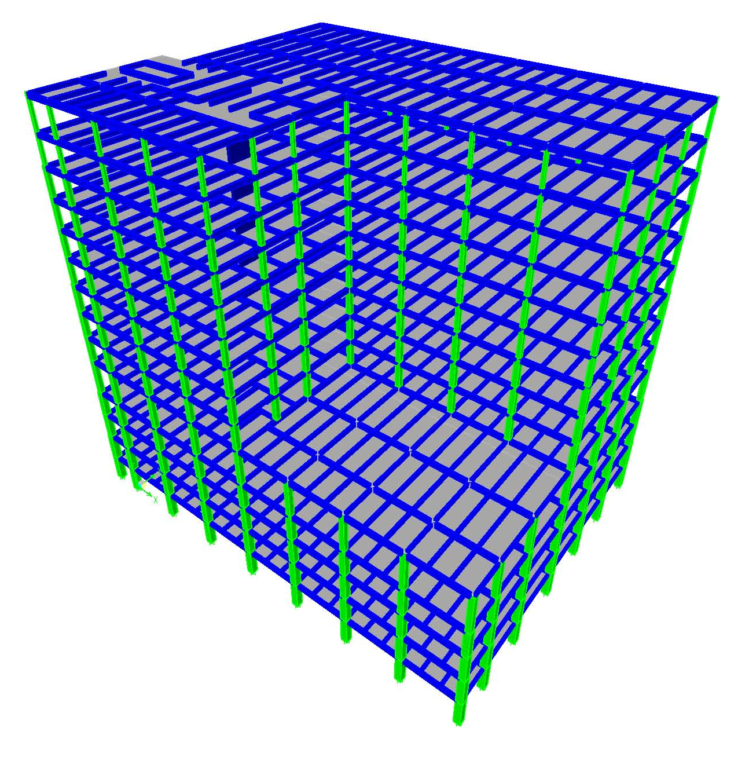
SMILOW CANCER HOSPITAL | 20 YORK STREET, NEW HAVEN, CONNECTICUT
DANIELE R. NAVARRETE | STRUCTURAL OPTION
STRUCTURAL DEPTH:
Proposed Reinforced Concrete Structural System
Concrete Moment Frames + Existing Shear Walls
Typical Bay: 30’ x 30’ (with intermediate beams at 10’)
Floor Slab: 5” thick, one-way floor slab (ACI deflection criteria)
Beams: 12” x 25”
Girders: 16” x 30”
Interior Columns: 16” x 16” to 40” x 40”
http://www.engr.psu.edu/ae/thesis/portfolios/2009/don5000

Slide 14
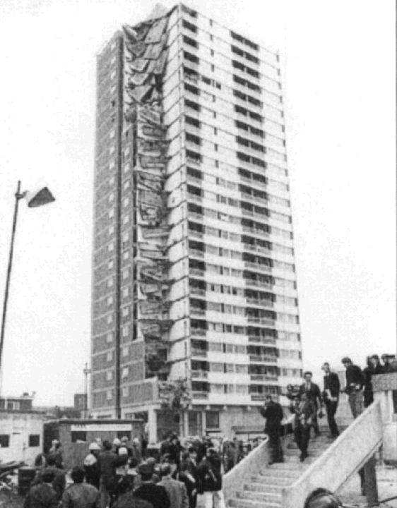
SMILOW CANCER HOSPITAL | 20 YORK STREET, NEW HAVEN, CONNECTICUT
DANIELE R. NAVARRETE | STRUCTURAL OPTION
STRUCTURAL DEPTH:
Progressive Collapse Design
“…the spread of an initial local failure from element to element, eventually resulting in the collapse of an entire structure or a disproportionately large part of it.”
          ASCE 7-02
Progressive collapse design in the U.S. governed by Unified Facilities Criteria (UFC) 4-023-03 “Design of Buildings to Resist Progressive Collapse” published by the Dept. of Defense.
Ronan Point Apartment Tower Collapse
London, 1968
wikipedia.org
http://www.engr.psu.edu/ae/thesis/portfolios/2009/don5000

Slide 15
SMILOW CANCER HOSPITAL | 20 YORK STREET, NEW HAVEN, CONNECTICUT
DANIELE R. NAVARRETE | STRUCTURAL OPTION
STRUCTURAL DEPTH:
Progressive Collapse Design
UFC 4-023-03 outlines two design approaches: direct and indirect.
Direct method relies on the idea of an “alternate path” and typically means beams and girders must be designed for longer spans as columns are “removed” from the structure.
Indirect method relies on the “catenary” response of the structure. Goal is to develop adequate tie forces within beams and slabs. Allows for evacuation time in the event of column failure.
http://www.engr.psu.edu/ae/thesis/portfolios/2009/don5000

Slide 16
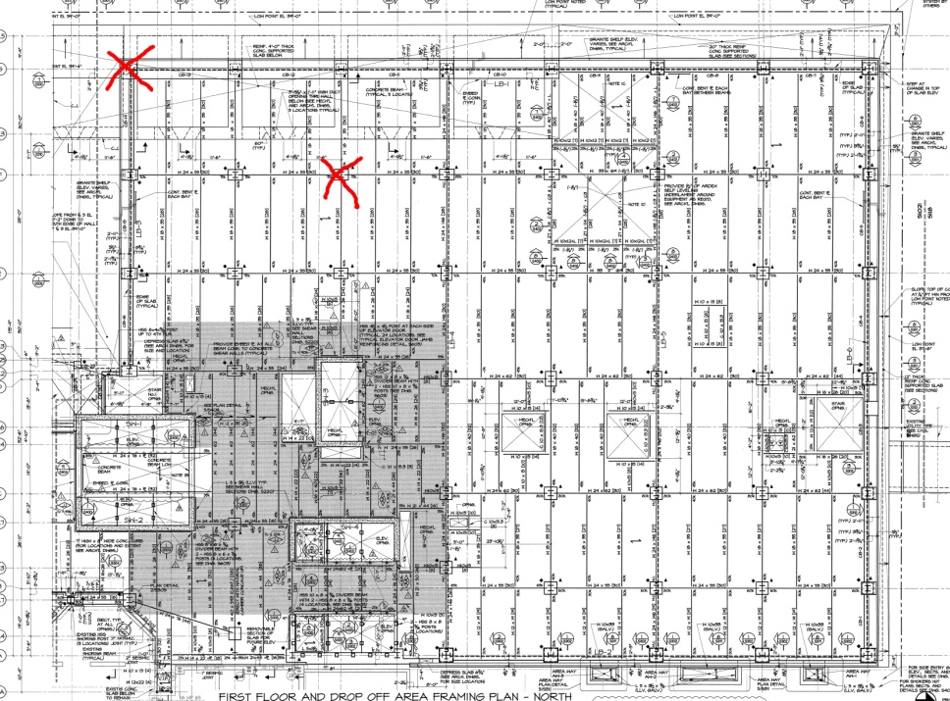
SMILOW CANCER HOSPITAL | 20 YORK STREET, NEW HAVEN, CONNECTICUT
DANIELE R. NAVARRETE | STRUCTURAL OPTION
STRUCTURAL DEPTH:
Progressive Collapse Design
Smilow Cancer Hospital assigned a Low Level of Protection (LLOP); therefore, only Indirect Method required.
Blast Scenarios:
Corner Column Failure
Interior Column Failure
http://www.engr.psu.edu/ae/thesis/portfolios/2009/don5000

Slide 17
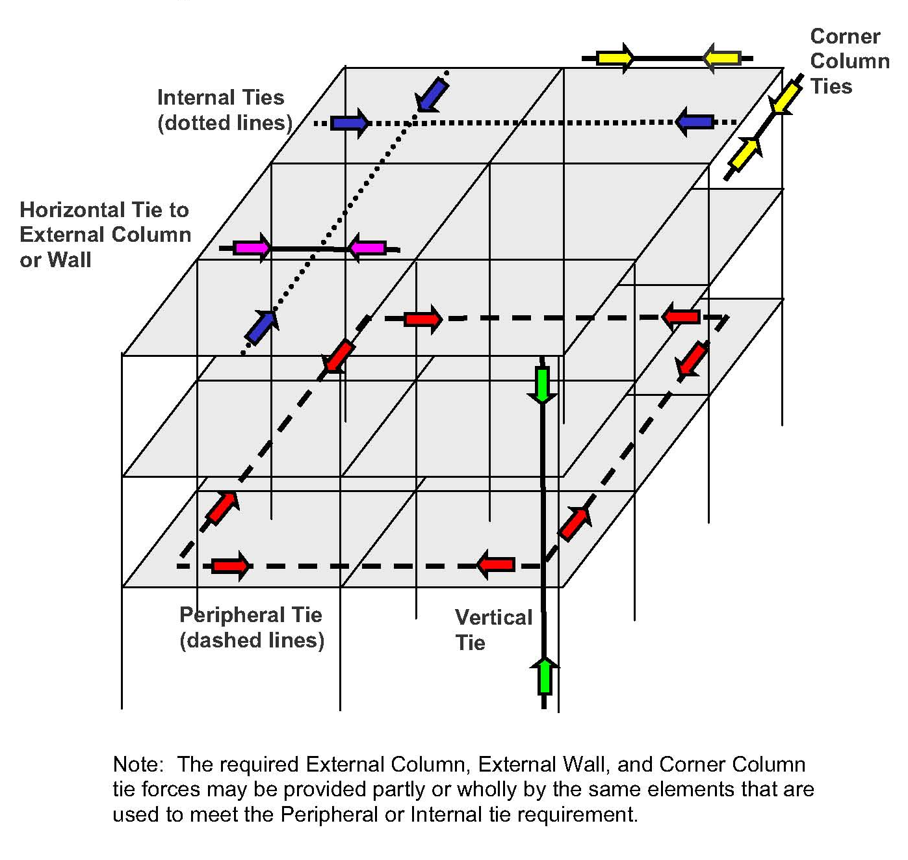
SMILOW CANCER HOSPITAL | 20 YORK STREET, NEW HAVEN, CONNECTICUT
DANIELE R. NAVARRETE | STRUCTURAL OPTION
STRUCTURAL DEPTH:
Progressive Collapse Design
Location of required ties for Indirect Method:
http://www.engr.psu.edu/ae/thesis/portfolios/2009/don5000

Slide 18
SMILOW CANCER HOSPITAL | 20 YORK STREET, NEW HAVEN, CONNECTICUT
DANIELE R. NAVARRETE | STRUCTURAL OPTION
STRUCTURAL DEPTH:
Progressive Collapse Design
Provided flexural reinforcement in slabs, beams, girders, and columns are adequate to develop required tie forces. Reinforcement must now be detailed to meet the ductility requirements for the indirect method.
http://www.engr.psu.edu/ae/thesis/portfolios/2009/don5000

Slide 19
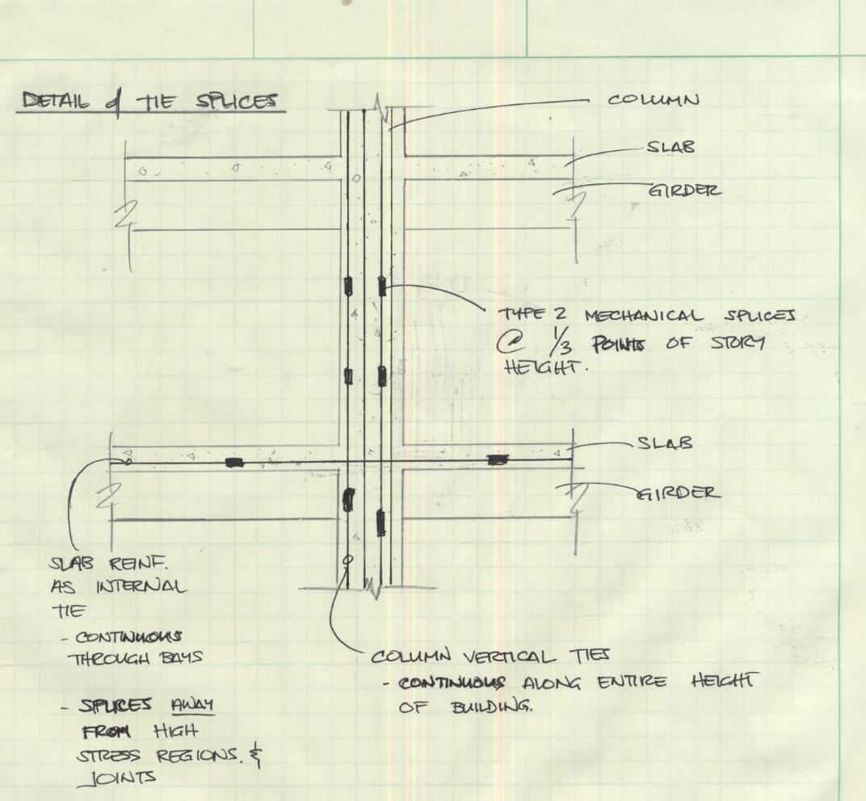
SMILOW CANCER HOSPITAL | 20 YORK STREET, NEW HAVEN, CONNECTICUT
DANIELE R. NAVARRETE | STRUCTURAL OPTION
STRUCTURAL DEPTH:
Progressive Collapse Design
Detailing Requirements:
Vertical ties to be continuous along entire height of building with Type 2 mechanical splices at third points of column heights.
Horizontal ties to be continuous through bays with splices away from joints and regions of high stress.
http://www.engr.psu.edu/ae/thesis/portfolios/2009/don5000

Slide 20
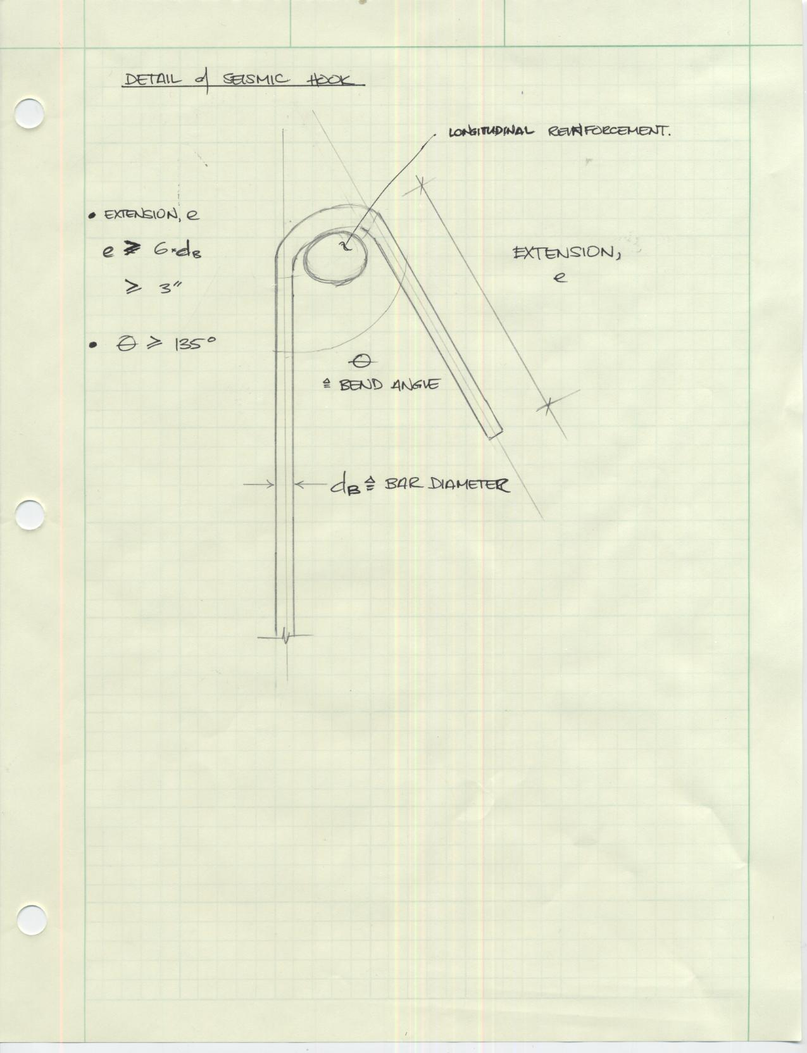
SMILOW CANCER HOSPITAL | 20 YORK STREET, NEW HAVEN, CONNECTICUT
DANIELE R. NAVARRETE | STRUCTURAL OPTION
STRUCTURAL DEPTH:
Progressive Collapse Design
Detailing Requirements:
“Seismic” hook to be used at all tie interfaces.
http://www.engr.psu.edu/ae/thesis/portfolios/2009/don5000

Slide 21
SMILOW CANCER HOSPITAL | 20 YORK STREET, NEW HAVEN, CONNECTICUT
DANIELE R. NAVARRETE | STRUCTURAL OPTION
BREADTH STUDY
http://www.engr.psu.edu/ae/thesis/portfolios/2009/don5000

Slide 22
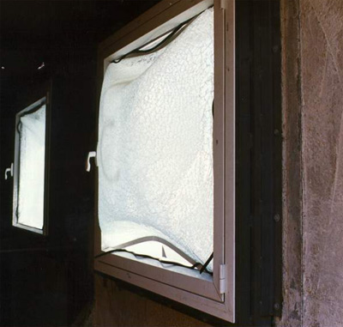
SMILOW CANCER HOSPITAL | 20 YORK STREET, NEW HAVEN, CONNECTICUT
DANIELE R. NAVARRETE | STRUCTURAL OPTION
BLAST-RESISTANT GLAZING:
Design Criteria
Design blast pressures are based on charge size and stand-off distance.
Primary design goal is to mitigate the effects of flying glass shards due to blast pressures.
Glass fracture is not only acceptable, but expected.
Blast design based on ASTM F 2248 standard.
Oran Safety Glass® (OSG)
http://www.engr.psu.edu/ae/thesis/portfolios/2009/don5000

Slide 23
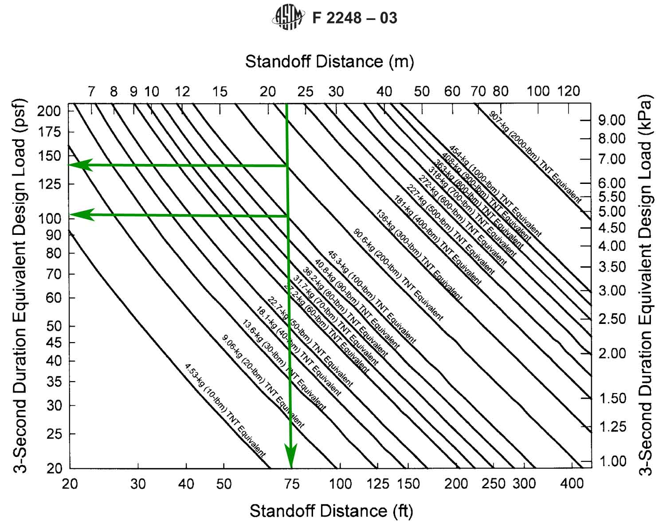
SMILOW CANCER HOSPITAL | 20 YORK STREET, NEW HAVEN, CONNECTICUT
DANIELE R. NAVARRETE | STRUCTURAL OPTION
BLAST-RESISTANT GLAZING:
Design Criteria
ASTM F 2248 chart relates stand-off distance and charge mass to 3-second equivalent design load.
  Stand-off distance = 75’
  Charge Mass = 100 lbm & 200 lbm
  3-second Design Load =
  100 psf & 140 psf
  Typical Design Wind Load =
  15-20 psf
ASTM F 2248: Specifying an Equivalent 3-second Duration Design Loading for Blast Resistant Glazing
http://www.engr.psu.edu/ae/thesis/portfolios/2009/don5000

Slide 24
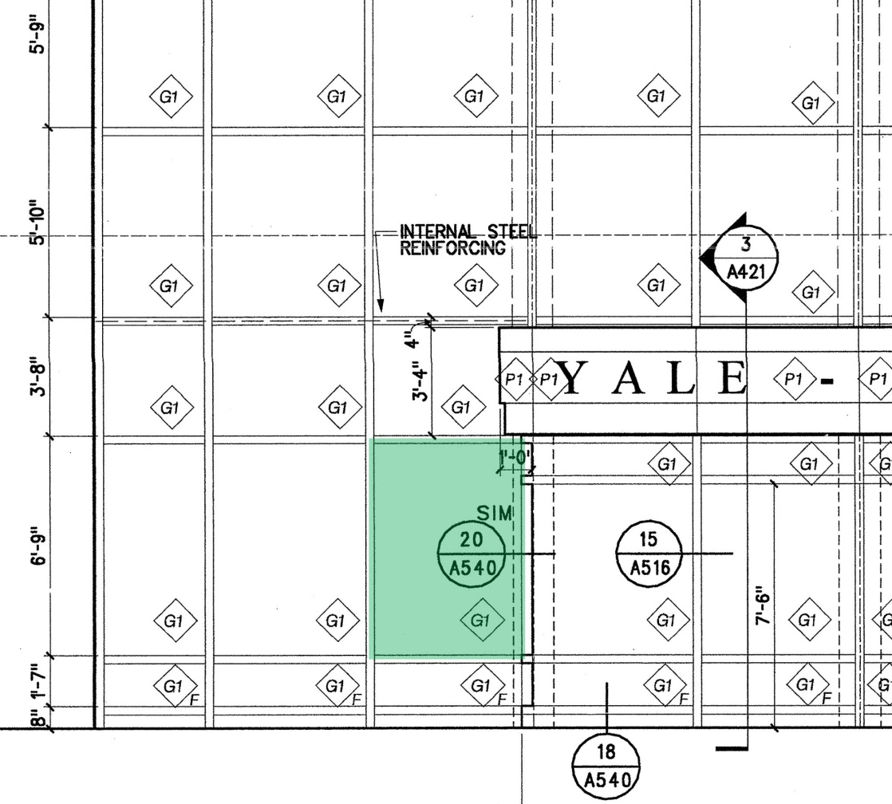
SMILOW CANCER HOSPITAL | 20 YORK STREET, NEW HAVEN, CONNECTICUT
DANIELE R. NAVARRETE | STRUCTURAL OPTION
BLAST-RESISTANT GLAZING:
Existing Design Analysis
Critical glazing panel on first floor lobby façade:
  6’-9” x 5’-0” (81” x 60”)
  A = 33.75 sq. ft. (4860 sq. in.)
  Aspect Ratio = 1.35
  1” Insulating Glass Unit (IGU)
    (2) ¼” HS lites
    ½” air space
http://www.engr.psu.edu/ae/thesis/portfolios/2009/don5000

Slide 25
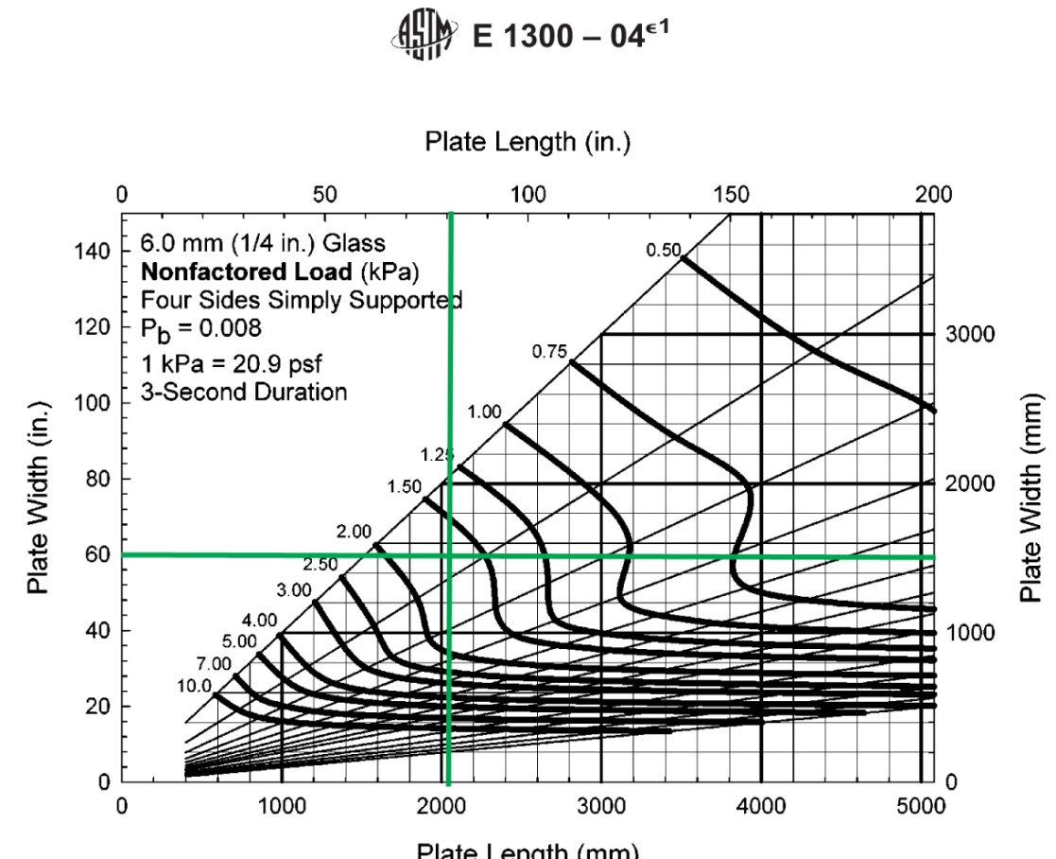
SMILOW CANCER HOSPITAL | 20 YORK STREET, NEW HAVEN, CONNECTICUT
DANIELE R. NAVARRETE | STRUCTURAL OPTION
BLAST-RESISTANT GLAZING:
Existing Design Analysis
ASTM E 1300 charts give base load-resistance value for annealed glass (non-factored load or NFL).
For critical panel,
  NFL = 1.70 kPa or 35.5 psf
ASTM E 1300: Determining Load Resistance of Glass in Buildings
http://www.engr.psu.edu/ae/thesis/portfolios/2009/don5000

Slide 26
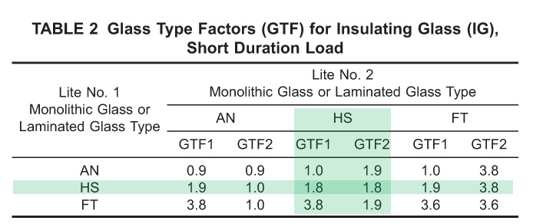
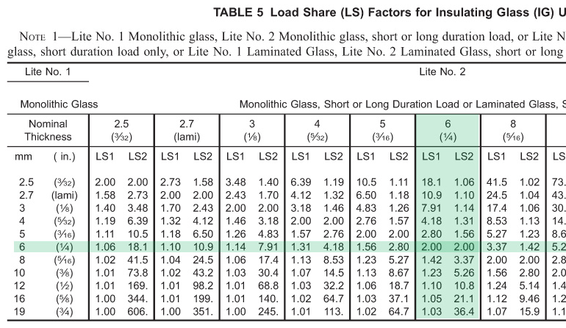
SMILOW CANCER HOSPITAL | 20 YORK STREET, NEW HAVEN, CONNECTICUT
DANIELE R. NAVARRETE | STRUCTURAL OPTION
BLAST-RESISTANT GLAZING:
Existing Design Analysis
ASTM E 1300 tables give modification factors for different glass types/configurations.
For heat-strenghtened glass, GTF = 1.8 [Table 2]
For IGUs with both lites @ ¼”, LSF = 2.0 [Table 5]
Load Resistance = NFL x GTF x LSF
  = 35.5 psf x 1.8 x 2.0
  = 128 psf
Therefore, current design is good for 100 lb charge, but not for 200 lb charge.
Tables 2 & 5 from ASTM E 1300 Standard
http://www.engr.psu.edu/ae/thesis/portfolios/2009/don5000

Slide 27
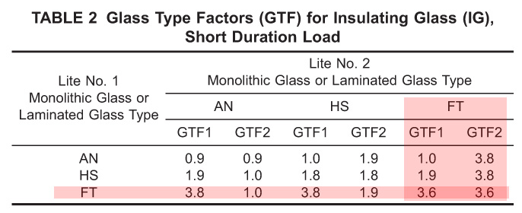
SMILOW CANCER HOSPITAL | 20 YORK STREET, NEW HAVEN, CONNECTICUT
DANIELE R. NAVARRETE | STRUCTURAL OPTION
BLAST-RESISTANT GLAZING:
Design for Blast-Resistance
To design for a 200 lb charge (140 psf), change glass type to fully-tempered (FT).
For fully-tempered glass, GTF = 3.6
  [Table 2]
For IGUs with both lites @ ¼”, LSF = 2.0
  [Table 5]
Load Resistance = NFL x GTF x LSF
  = 35.5 psf x 3.6 x 2.0
  = 256 psf > 140 psf
Use fully-tempered, laminated glass for blast-resistant design.
Tables 2 & 5 from ASTM E 1300 Standard
http://www.engr.psu.edu/ae/thesis/portfolios/2009/don5000

Slide 28
SMILOW CANCER HOSPITAL | 20 YORK STREET, NEW HAVEN, CONNECTICUT
DANIELE R. NAVARRETE | STRUCTURAL OPTION
BLAST-RESISTANT GLAZING:
Heat-Strengthened versus Fully-Tempered Glazing
Heat-Strengthened
Low level of residual stress
Some waviness from heat treatment
Tends to stay in opening after fracture, but can break into large, sharp pieces under blast loads
Fully-Tempered
High level of residual stress
Visible waviness from heat treatment
Breaks into relatively harmless “diced” pattern
About twice as strong as HS, but at a cost premium
http://www.engr.psu.edu/ae/thesis/portfolios/2009/don5000

Slide 29
SMILOW CANCER HOSPITAL | 20 YORK STREET, NEW HAVEN, CONNECTICUT
DANIELE R. NAVARRETE | STRUCTURAL OPTION
CONCLUSIONS
http://www.engr.psu.edu/ae/thesis/portfolios/2009/don5000

Slide 30
SMILOW CANCER HOSPITAL | 20 YORK STREET, NEW HAVEN, CONNECTICUT
DANIELE R. NAVARRETE | STRUCTURAL OPTION
CONCLUSIONS:
Progressive Collapse
Designing for progressive collapse using the Indirect Method is a feasible option.
For concrete structures, existing reinforcement is usually adequate to develop required tie forces.
Proper detailing of tie splices and connections is CRITICAL.
Blast-Resistant Glazing
Increasing stand-off distance is the best way to mitigate glazing failure due to blast loads.
Fully-tempered, laminated glass is the preferred material for blast-resistant glazing design.
The probability of an explosive attack must be assessed as accurately as possible, and the need for blast-resistant glazing must be determined accordingly.
http://www.engr.psu.edu/ae/thesis/portfolios/2009/don5000

Slide 31
SMILOW CANCER HOSPITAL | 20 YORK STREET, NEW HAVEN, CONNECTICUT
DANIELE R. NAVARRETE | STRUCTURAL OPTION
ACKNOWLEDGEMENTS
I would like to give thanks and show my appreciation to the following individuals for the support they have given me in the writing of this thesis:
The whole AE Department staff and faculty, especially…
  Dr. Ali Memari
  Prof. M. Kevin Parfitt
My family and friends
All of my fellow AE students, especially…
  Dan Donecker
http://www.engr.psu.edu/ae/thesis/portfolios/2009/don5000

Slide 32
SMILOW CANCER HOSPITAL | 20 YORK STREET, NEW HAVEN, CONNECTICUT
DANIELE R. NAVARRETE | STRUCTURAL OPTION
QUESTIONS & COMMENTS
http://www.engr.psu.edu/ae/thesis/portfolios/2009/don5000

